Slide 1
JAVASCRIPT FUNCTIONS

Slide 2
JavaScript Functions
JavaScript functions are used to perform operations. We can call JavaScript function many times to reuse the code.

Slide 3
Advantage of JavaScript function
Code reusability: We can call a function several times so it save coding.
Less coding: It makes our program compact. We don’t need to write many lines of code each time to perform a common task.

Slide 4
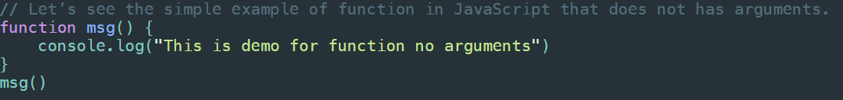
JavaScript Function No Arguments

Slide 5
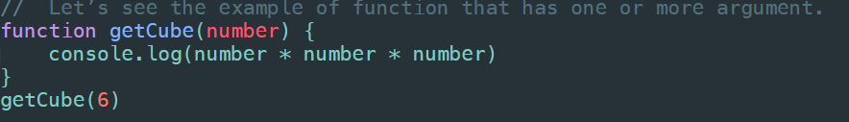
JavaScript Function Arguments

Slide 6
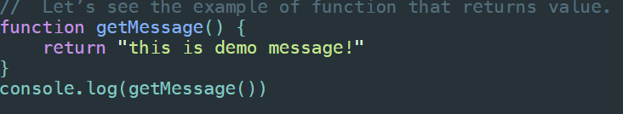
JavaScript Function with Return Value

Slide 7
JavaScript Function Object
In JavaScript, the purpose of Function constructor is to create a new Function object
It executes the code globally. However, if we call the constructor directly, a function is created dynamically but in an unsecured way.

Slide 8
JavaScript Function Object - Syntax
new Function ([arg1[, arg2[, ....argn]],] functionBody)
Parameters:
arg1, arg2, .... , argn - It represents the argument used by function.
functionBody - It represents the function definition.

Slide 9
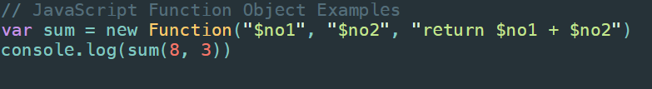
JavaScript Function Object - code

Slide 10
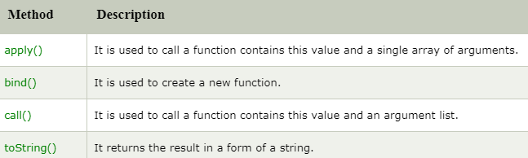
JavaScript Function Methods

Slide 11
JavaScript Function apply() method
The JavaScript Function apply() method is used to call a function contains this value and an argument contains elements of an array. Unlike call() method, it contains the single array of arguments.

Slide 12
JavaScript Function apply() method - syntax
function.apply(this-Argument, [array])
this-Argument - It is optional. The this value is given for the call to a function.
array - It is optional. It is an array-like object
It returns the result of the calling function along provided this value and arguments.

Slide 13
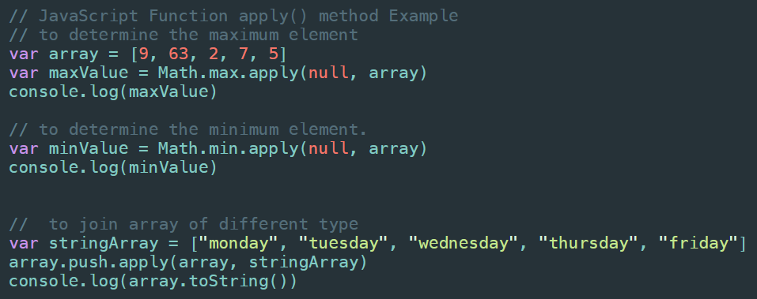
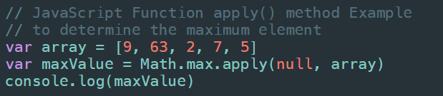
JavaScript Function apply() method – code

Slide 14
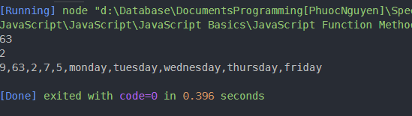
JavaScript Function apply() method – output

Slide 15
JavaScript Function bind() method
The JavaScript Function bind() method is used to create a new function
When a function is called, it has its own this keyword set to the provided value, with a given sequence of arguments.

Slide 16
JavaScript Function bind() method - syntax
function.bind(thisArg [, arg1[, arg2[, ...]]]
thisArg - The this value passed to the target function.
arg1,arg2,....,argn - It represents the arguments for the function.
It returns the replica of the given function along provided this value and initial arguments.

Slide 17
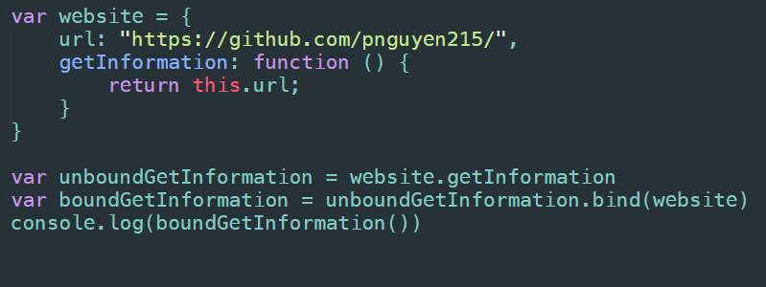
JavaScript Function bind() method – code 1

Slide 18

JavaScript Function bind() method – output 1

Slide 19
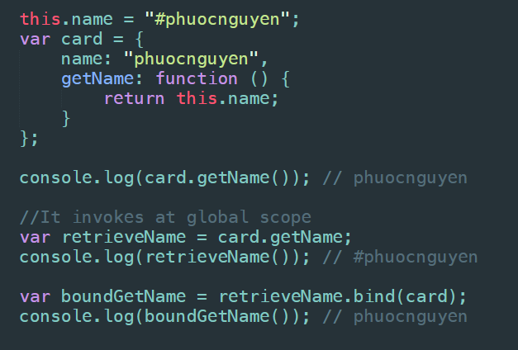
JavaScript Function bind() method – code 2

Slide 20
JavaScript Function call() method
The JavaScript Function call() method is used to call a function contains this value and an argument provided individually
Unlike apply() method, it accepts the argument list.

Slide 21
JavaScript Function call() method - syntax
function.call(thisArg, arg1,arg2,....,argn)
thisArg - It is optional. The this value is given for the call to function.
arg1,arg2,...,argn - It is optional. It represents the arguments for the function.
It returns the result of the calling function along provided this value and arguments.

Slide 22
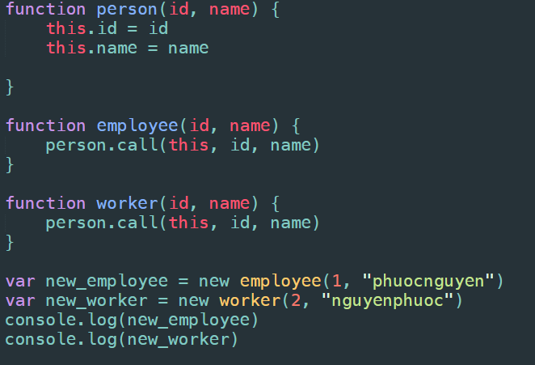
JavaScript Function call() method - code

Slide 23

JavaScript Function call() method - output

Slide 24
JavaScript Function toString() method
The JavaScript Function toString() method returns a string.
Here, string represents the source code of the function.

Slide 25
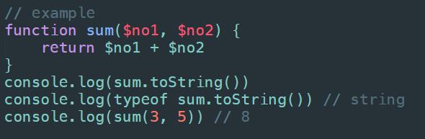
JavaScript Function toString() method – code

Slide 26
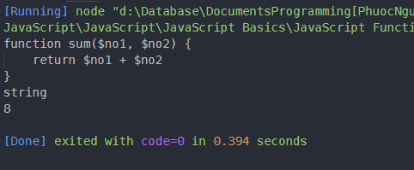
JavaScript Function toString() method – output

